Slide 1

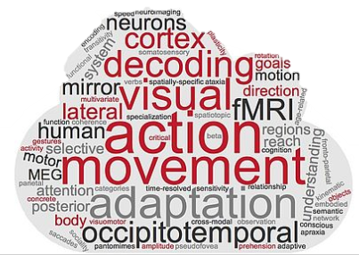
RSA - summary
Day 5
Tonghe & Zuza

Slide 2

Data collection: behavioral experiments
Meadows
SosciSurvey
Amazon Mechanical Turk
Recruitement of participants at Uni Regensburg: SONA

Slide 3
CoSMoMVPA: other analyses
Various types of neuroimaging data (fMRI, EEG, MEG)
Functions:
Dataset processing (normalize, randomize targets, etc.)
MEG/fMRI related functions
Data visualization
Classification and cross-validation
RSA
Feature-based clustering
Statistics
….

Slide 4
VIFs
A variance inflation factor (VIF) is a measure of the amount of multicollinearity in regression analysis. Multicollinearity exists when there is a correlation between multiple independent variables in a multiple regression model. This can adversely affect the regression results. Thus, the variance inflation factor can estimate how much the variance of a regression coefficient is inflated due to multicollinearity.

Slide 5
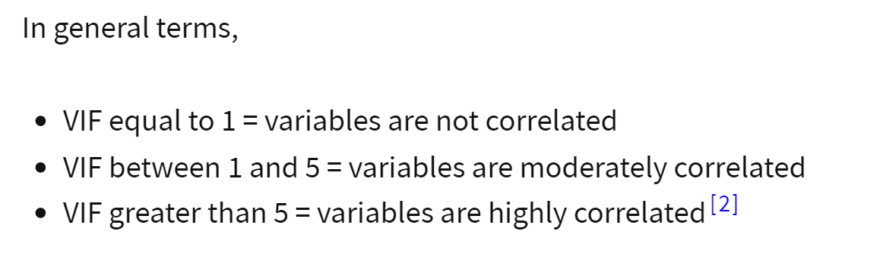

Slide 6
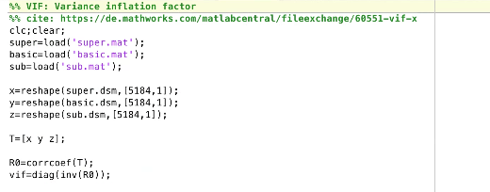
codes for VIFs

